Slide 1

Starter Task
Log into your PC
Open Teams and go to our class Team (4E Computing)
If you have done so:
You can see me about your assessment mark
(Answers will be released soon)

Slide 2
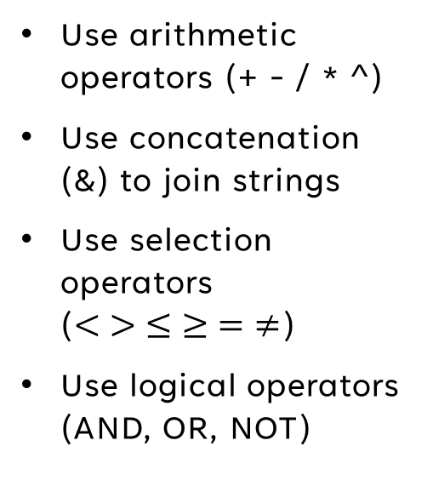
Learning intentions and success criteria
I am learning…
I can…
About the arithmetic operations and concatenation
About selection constructs and logical operators
Use arithmetic operators (+ - / * ^)
Use concatenation (&) to join strings
Use selection operators ($< > ≤ ≥ = ≠$)
Use logical operators (AND, OR, NOT)

Slide 3

Expressions & Operators
N5 - Software Design & Development

Slide 4

Data Types Recap
Last time, we covered different data types:
Data Type | Contents | Example
CHAR | Single character | “A”, “B”, “C”
STRING | Text characters | “Glasgow” “C3P0”
INTEGER | Whole Number | 2, 15, 18, 100
REAL | Real Number | 2.45, 3.9, 12.994
BOOLEAN | True or False Value | True, False

Slide 5
Variables
Variables store a single piece of data.
They can be used to store or display information
GET username from KEYBOARD
SEND welcome_message to DISPLAY
A variable must be declared before it can be assigned a value
DIM age as INTEGER
age = 15
When you declare a variable, you can initialise it with an initial value
DIM temperature as REAL = 0.00

Slide 6
Variable Terms
Declaring
Creating a new variable and setting its name and data type
DIM is_raining as BOOLEAN
Assigning
Giving a variable a value
is_raining = True
Initialising
Resetting or clearing the contents of a variable before use
Giving a variable an initial value after declaring it
sum = 0

Slide 7
Expressions
An expression is a combination of variables, constants and operators which may be evaluated to determine a result.
For example:
sum = 1 + 2
average = total / 3
area = length * height
message = “Hello” & name
And also:
5 > 3
6 = 2
num1 < num2

Slide 8
Arithmetic Operations
Calculations that are performed within a program. They include arithmetic operators, such as:
Operator | Meaning | Example
+ | Plus | 2 + 4 = 6
- | Minus | 7 – 5 = 2
* | Multiply | 4 * 3 = 12
/ | Divide | 100 / 4 = 25
^ (sometimes **) | Exponent | 3 ^ 2 = 36 2 ** 8 = 256

Slide 9
Concatenation
An expression can also contain concatenation, which is when two or more strings are joined together.
Operator | Meaning | Example
& | Concatenate | “Fire” & “man” = “Fireman”
Variables which are strings can be used in concatenation:
Word1 = “Seven”
Word2 = “Six”
annoying_catchphrase = Word2 & Word1
annoying_catchphrase = ???

Slide 10
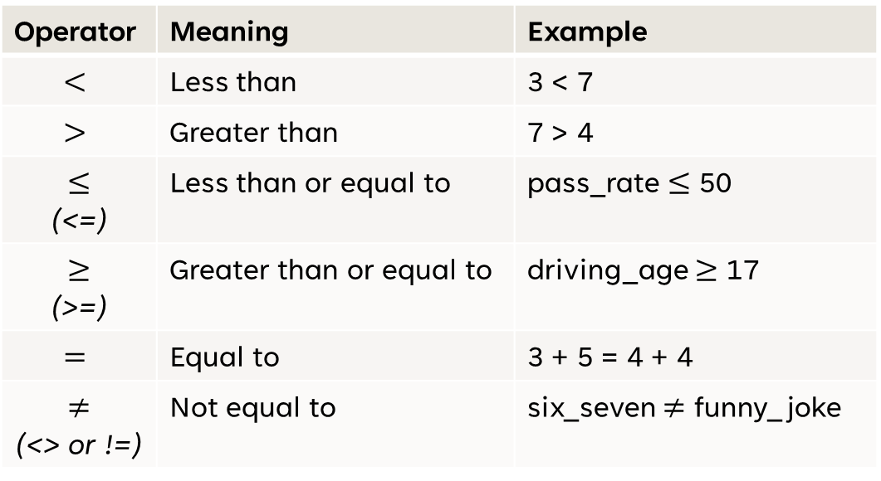
Selection Constructs
In conditions (“if” statements), you often use selection operators such as:
Operator | Meaning | Example
$$<$$ | Less than | 3 < 7
$$>$$ | Greater than | 7 > 4
$$≤$$ (<=) | Less than or equal to | pass_rate $≤$ 50
$$≥$$ (>=) | Greater than or equal to | driving_age $≥$ 17
$$=$$ | Equal to | 3 + 5 = 4 + 4
$$≠$$ (<> or !=) | Not equal to | six_seven $≠$ funny_joke

Slide 11
Evaluating Expressions
Selection operations will always result in either True or False
Expression | Result
5 > 3 | True
2 < 10 | True
9.4 = 2.0 + 5.5 | False
10 >= 10 | True
(5 – 3) <> (1 + 1) | False
(10 ^ 2) / 2 = 55 | False

Slide 12
Evaluating Expressions Quiz

Slide 13
A handy Shortcut
In a condition, you can check a variable’s “Truth” without needing to write = True or = False.
For example:
IF has_license = True THEN
DISPLAY “You can drive”
END IF
Is the same as:
IF has_license THEN
DISPLAY “You can drive”
END IF
This only works for variables that have a Boolean data type!

Slide 14
Logical Operators
Simple conditional statements contain just one expression. For example:
IF age >= 18 THEN
IF password = “MrW4NG” THEN
IF length * height < 100 THEN
Complex conditional statements contain two or more expressions:
IF temperature > 0 AND temperature < 25 THEN
IF age < 16 OR verified = False THEN
IF size = “Medium” OR NOT in_stock THEN
IF has_showered AND has_dressed AND has_eaten THEN

Slide 15
Logical Operators - AND
Sometimes we need to meet more than one condition in order for selection to be made.
For example:
IF correct_password AND verified_email THEN
DISPLAY “Logged In”
ELSE
DISPLAY “Your password or email is incorrect/unverified”
END IF
When using AND, both statements must be True in order for the expression as a whole to be True.

Slide 16
Logical Operators - AND
Another example is to check if a value is in a certain range (e.g. between a min and a max number).
IF score < 70 AND score >= 60 THEN
DISPLAY “You got a B!”
END IF
Score | Is the message displayed?
65% | Yes (Both conditions met)
32% | No (Only 2nd condition met)
87% | No (Only 1st condition met)
60% | Yes (Both conditions met)

Slide 17
Logical Operators - OR
Sometimes only one condition out of multiple needs to be met:
For example:
IF has_jacket = True OR is_raining = False THEN
DISPLAY “You can go outside”
END IF
Score | Can you go outside?
No jacket, not raining | Yes (2nd condition met)
Has jacket, not raining | Yes (Both conditions met)
No jacket, is raining | No (Neither conditions met)
Has jacket, is raining | Yes (1st condition met)

Slide 18
Logical Operators - NOT
Sometimes, you want to check if an expression is Not True.
For example:
IF NOT (age >= 18) THEN
DISPLAY “You are not an adult”
END IF
But why would we do this instead of:
IF age < 18 THEN
Sometimes, using NOT is more readable.

Slide 19
Logical Operators - NOT
When you already have a complex condition, it may be shorter and clearer to negate the whole thing rather than flipping every part.
For example:
IF NOT (score >= 50 AND attendance >= 75) THEN
PRINT “Pupil fails."
END IF
Is the same as:
IF score < 50 OR attendance < 75 THEN
PRINT “Pupil fails."
END IF
The first way can be easier to follow because it matches the natural rule: “Fail if not meeting both requirements.”

Slide 20
Logical Operators - NOT
Sometimes, you want to check if an expression is Not True.
For example:
IF NOT (age >= 18) THEN
DISPLAY “You are not an adult”
END IF
But why would we do this instead of:
IF age < 18 THEN
Sometimes, using NOT is more readable.

Slide 21
Truth Tables
A truth table is a way of showing all the possible outcomes of a logical expression.
Truth table for AND:
This shows that both A and B must be True for the expression to be True.
Variable A | Variable B | A AND B
True | True | True
True | False | False
False | True | False
False | False | False

Slide 22
Truth Tables
A truth table is a way of showing all the possible outcomes of a logical expression.
Truth table for OR:
This shows that either A or B must be True for the expression to be True.
Variable A | Variable B | A OR B
True | True | True
True | False | True
False | True | True
False | False | False

Slide 23
Truth Tables
A truth table is a way of showing all the possible outcomes of a logical expression.
Truth table for NOT:
This shows that NOT simply flips the truth value.
A | NOT A
True | True
False | False

Slide 24
Logical Operators Quiz

Slide 25
Learning intentions and success criteria
I am learning…
I can…
About the arithmetic operations and concatenation
About selection constructs and logical operators
Use arithmetic operators (+ - / * ^)
Use concatenation (&) to join strings
Use selection operators ($< > ≤ ≥ = ≠$)
Use logical operators (AND, OR, NOT)

